Slide 1
2024/25 School Planning
School Development Plan &
School Budget & Fees

Slide 2
2024-2025 School Planning
Welcome
Agenda
    Presentation
    Q & A
    Gather feedback
    Meeting evaluation

Slide 3
2024-2025 School Planning
The purpose of this meeting is to:
  Share information about our SDP and school budget and fees
  Gather feedback that may be considered in making future school planning decisions

Slide 4

Notes:
What is School Planning?
This video was developed to provide you with more information about school budgets and school fees.

Slide 5
School Development Plan
Literacy-Developing and enriching students' vocabulary
Mathematics-Developing consistent and clear math vocabulary that reflects curricular objectives
Well-Being- Building positive Relationships

Slide 6
Our School Budget
Our school received $2,785,135.00 in 2023-24 to provide a quality education to our students and meet the goals in our school development plan (SDP).
At least 75 per cent of budgeted funds covers staffing and the remaining portion covers instructional and operational supplies.
Notes:
Most aspects of a school development plan are independent of the school budget. However, budget may affect how we implement a school development plan. For instance, if a school development plan identifies English language learning as the focus, the school could elect to allocate part of their budget to hiring a teacher to support English language learners and build teacher capacity in this area. In other cases, schools may also consider parent fundraising to enrich supports currently available (e.g., expand the collection of dual language books in the school’s learning commons).
The vast majority of funding goes to staffing. The remaining portion pays for supplies and other resources.
[Add more detail about the instructional and operational supplies at your school.]

Slide 7
Our 2023-24 School Budget
Our student enrolment for the current year is 358.
RAM Allocations
Per School Total |  | $732,609.00
Per Student Total |  | $1,837,816.00
Total RAM Allocations |  | $2,785,135
RAM Deployment | Scenario A
Organization |  | FTEs
Teachers/Administration | $2,191,539 | 19.6
Support Staff | $495,716 | 8.7
Contract Absences | $39,111
Total Staffing | $2,726,366 | 28.3
Supplies/Other | $58,769
Notes:
Populate the table with your school budget information for 2023-24. You can find this information within the Messaging tab of your 2023-24 Fall RAM.

Slide 8
Our 2023-24 School Fees
We will consult with families by outlining proposed activities for the upcoming year that may require a fee for cost recovery.
Examples:
  Field trips
  In-school activities
  Artist in residence
Notes:
You may want to discuss some of the following topics:
How fees, fundraising and budget are interconnected.​
How parent society fundraising $s were used to lower/eliminate some fees​
What the major categories of fees were at the school​
School-based fees vs. central CBE fees (e.g., transportation, noon supervision)​
Average fee per student (per grade?)
Differences when compared with last year’s school fees

Slide 9
Our 2023-24 School Fees
https://www.cbe.ab.ca/registration/fees-and-waivers/SchoolFees/Ranchlands-Fees.pdf
Notes:
[Find your school-specific link to approved fees here: https://www.cbe.ab.ca/registration/fees-and-waivers/Pages/find-my-school-fees.aspx]
This is the list of approved school fees for 2023-24. In August, the fees for the 2024-25 school year will be posted.
School fees are only charged to cover the cost of an activity. Based on what we know at this time, fees for 2024-25 will be similar to what you see for this year [customize/consider adding a slide if this is not the case for your school]. You may see an increase in fees where the cost of an activity (or a material associated with the activity) has increased.
[Customize for your school context. Based on what you know at this point in time, discuss any possible new, increasing or decreasing fees for 2024-25. Make sure you express the rational for any possible changes in fees.]

Slide 10
Our 2023-24 School Fees
2022-23 Report to Parents on Fees
https://ranchlands.cbe.ab.ca/documents/72bcf51a-2e89-504e-bf5e-3ee37b8d251c/Report-to-Parents-on-Fees-2022-2023.pdf

Slide 11
Questions?
We’ll take a few minutes to answer questions about our school budget and fees.
Notes:
Pause at this slide until your Q&A is finished.
You may want to remind participants that this Q&A is to clarify anything that was unclear in the presentation up to this point and that there will be an opportunity to provide feedback.
It is recommended that someone keeps time.

Slide 12
Gathering Your Feedback
Feedback is important as we consider school planning. When students, families and staff work closely together, students achieve greater success in their learning.
We’d now like to gather your feedback on some specific questions.
Notes:
Please provide your comments and thoughts.
TIP: Prepare some ‘probing questions’ beforehand to help encourage and guide the conversation. If you are holding a virtual meeting, you can also consider using the Teams Polls to gather feedback on specific questions – you can do this at various points during the presentation/session.
TIP: Have someone take notes to capture comments and feedback.

Slide 13
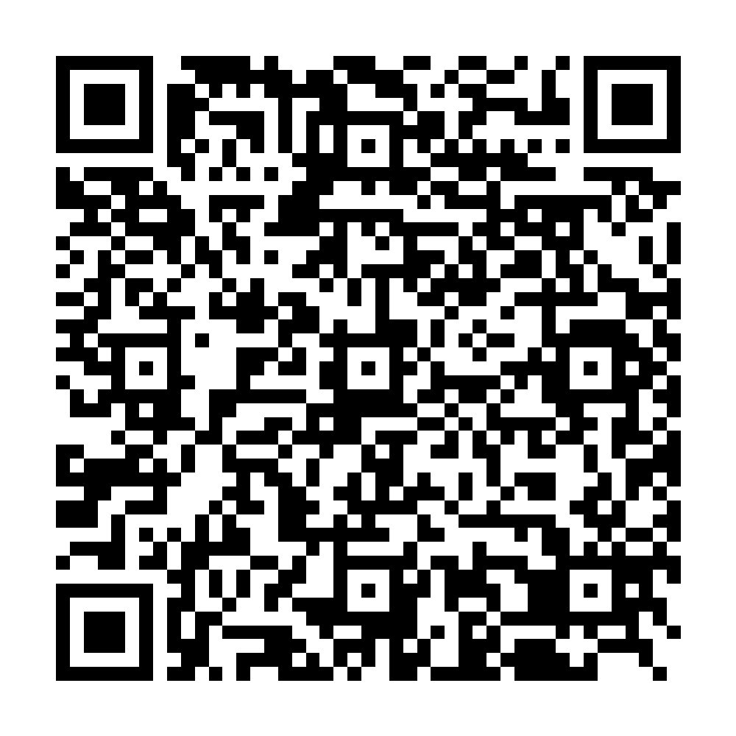
Gathering Your Feedback
  https://ranchlands.cbedialogue.com/en/projects/2024-2025-school-year/engagements/school-planning-survey-2024-elementary
Survey will remain open until March 22, 2024

Slide 14
Next Steps
We will provide feedback from this survey at School Council on April 9, 2024

Slide 15
Wrap-Up
Thank you for your participation!
Please take a few minutes at this time to share your feedback about this meeting.
Notes:
We want to make sure our meetings meet your needs and expectations. That's why we are asking for your feedback on this meeting. Your feedback is the only way we will know what we're doing well and what we can improve at future meetings. So please do take a few minutes to share your feedback. We will share a summary of responses on our website later this spring.

